Slide 1
INVOICE PROCESSING USING RPA
Team Members
1.Nandha kumar.A
2. Rakshana.B
3.Surya kala.M
Facultyguide : Industrial guide :
Mr. Suresh kumar R Mrs. Pavithra
Assistant professor
Department of CSE
Department of CSE, KGiSL Institute of Technology, Coimbatore

Slide 2
Abstract
Invoice processing using RPA has performed with a help of Ui-Path. Collect a invoice template in different format and read those mails in ui-path.
Processing those unread mails by using required activities. Depend on those activities we automate the mail.
Then convert those PDF file to Excel sheet format.
Department of CSE, KGiSL Institute of Technology, Coimbatore

Slide 3
Area Introduction-Existing system
The Client uses MS EXCEL,and maintains their product list,customer list and print the invoice ,however it is not possible to share the data from multiple system in multi user environment.
It contain lot of duplicate work and also changed of mistake.
When the product price are no security everyone can access any report and sensitive data,also no report to find the sales volume,stock ,stock list and summary report.
Department of CSE, KGiSL Institute of Technology, Coimbatore

Slide 4
Proposed System
The invoice system is used to overcome the entire problem which they are facing currently, and making complete automation of billing and invoice system.
The first step of the process consists out of the selection of the right PDF invoice in a dedicated folder.
For the RPA bot, it does not matter which application is used to process the invoice data. This can be any kind of accounting.
And next step reading the invoice form the folder one by one and extracting the key information from the invoice data.
After success fully registering the each invoice ,the software robots are then able to send posting notifications in the form of emails to responsible employees.
Other background activities, During this whole process the software robots are also running background activities such as monitoring the dedicated invoice folder or its email address, performing basic checks to see is company's database is open and verifying by the vendor information. And the invoice matches what is already in the database.
Department of CSE, KGiSL Institute of Technology, Coimbatore

Slide 5
Literature Review
Drawbacks of existing methods
There are some potential downsides to using invoices, but these are mostly caused by poor management and inadequate process.
High operational costs per invoice on both sender and receiver side
References
https://www.uipath.com/blog/uipath-at-work-automating-the-invoice-process
https://www.image-1.com/document-scanning-service-blog/rpa-for-ap-invoice-processing-automation/
Department of CSE, KGiSL Institute of Technology, Coimbatore

Slide 6
Architectural Design
Submit Email Login
START
Notification to Client
Unread Message
Receive Email
Read as a PDF
Extract to Excel
Department of CSE, KGiSL Institute of Technology, Coimbatore

Slide 7
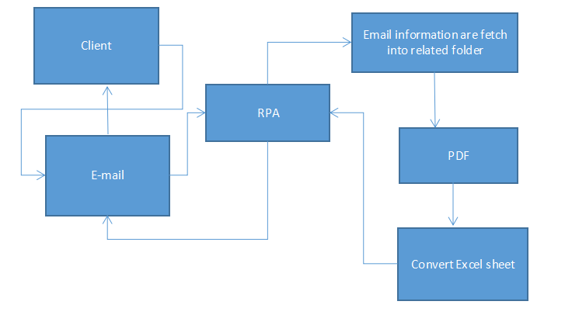
DFD Diagram
Level 0

Slide 8
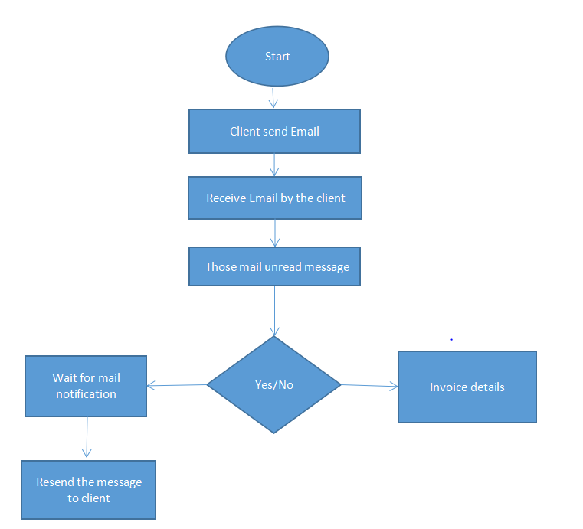
DFD Diagram
Level 1

Slide 9
Module Splitup
Module I:
Create a invoice template.
Attach a template into email.
Module II:
Read a unread message using Ui-Path.
Convert into required PDF.
Module III:
Create a flow for all invoice.
Convert those invoice from PDF to Excel sheet.
And send a mail notification to the required client.
Department of CSE, KGiSL Institute of Technology, Coimbatore

Slide 10
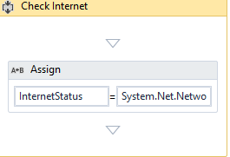
Screen shots of modules under progress.
Check internet status:
Department of CSE, KGiSL Institute of Technology, Coimbatore

Slide 11
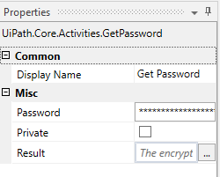
Get Password:

Slide 12
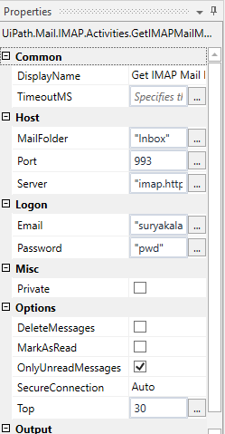
Get IMAP mail messages:

Slide 13
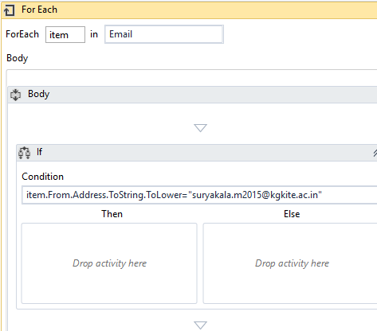
For Each:

Slide 14
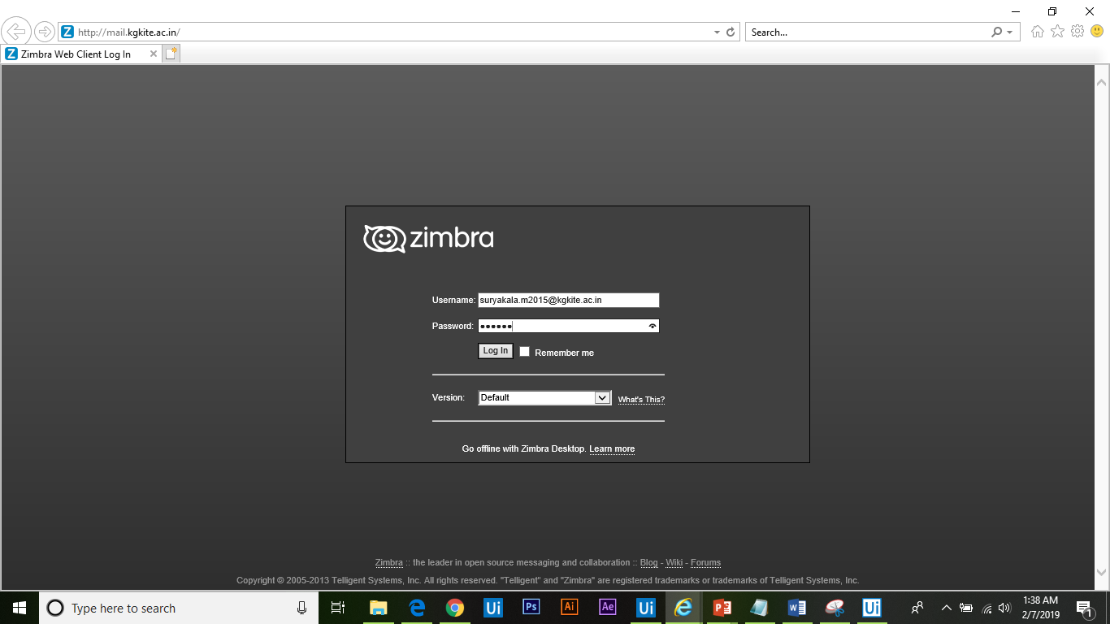
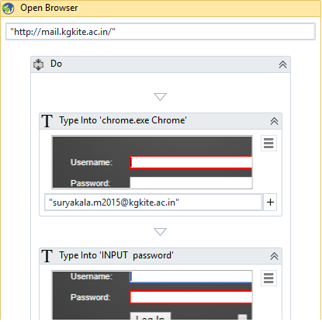
Output:

Slide 15
Thank You
Department of CSE, KGiSL Institute of Technology, Coimbatore

